Slide 1

Data collection
Research Skills
Adv Dip ICT
Dr Alveen Singh
Semester 1 2022

Slide 2
Content
Quantitative data collection
Qualitative data collection
Survey
Focus group

Slide 3
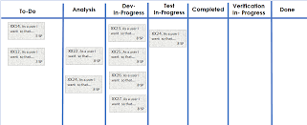

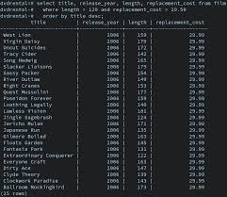

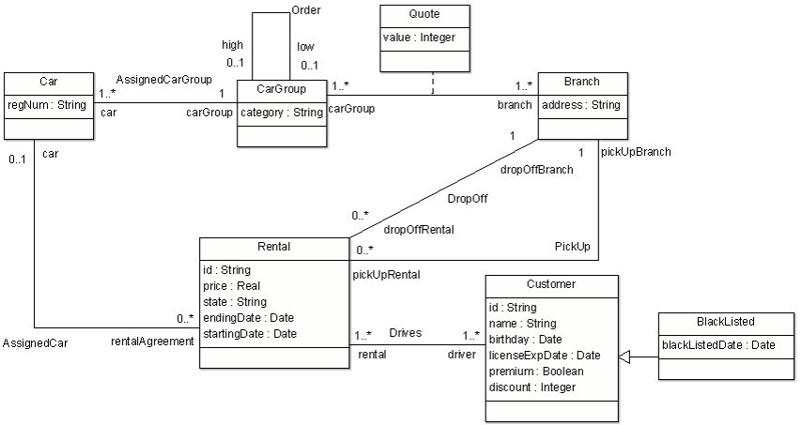
Introduction
Research is largely dependent on the ability to extract useful information (results) from collected data
There are several techniques for data collection
Sample

Slide 4


Types of data collection
Quantitative or Qualitative
Thebalancecareers.com

Slide 5



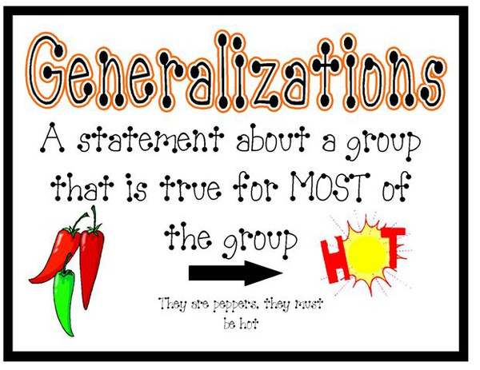
Quantitative
lonestar.com
Kyleads.com
Quantitative data collection methods rely on predetermined sampling and structured data collection instruments.
The collected data can be summarized, compared and generalized
Unstats.un.org
Mrswarnerslearningcommunity.com

Slide 6

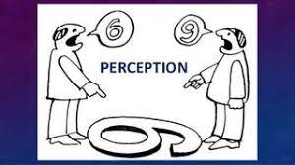
Qualitative Data
Qualitative data is for understanding perceptions and people’s perceived reality.
Qualitative research can often be used prior to a quantitative data collection in helping to generate hypothesis, design the survey and questionnaires.
Mixed approaches
Careeradict.com
psycologytoday.com

Slide 7
Quantitative data collection
Usually includes a large sample
  Generalization
Data is numerical (or converted to numbers) which is easily quantifiable. Closed ended questions are often used for this purpose.
Can include opinions, perceptions and variables to support or reject a hypothesis or answer a research question
  Convert responses to numbers for analysis

Slide 8

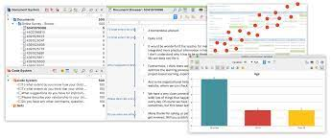
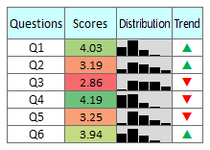



maxqda.com
clipartbay.com
citoolkit.com
paperform.com
simplysfdc.com

Slide 9


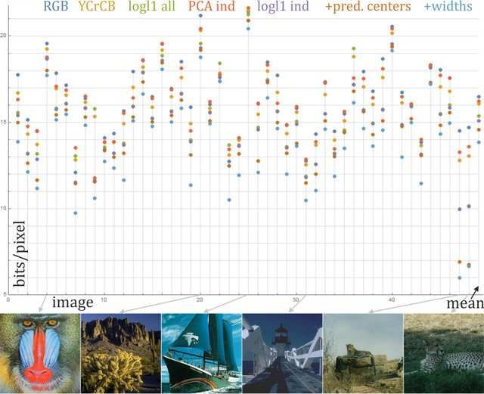
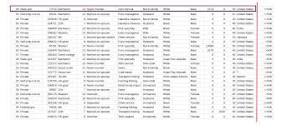
Quantitative data can also include images, sound or datasets (e.g. twitter, ITS student records, software product metrics).
Quantitative data can be generated from experiments, surveys and interviews, IoT sensor data, drones etc.
Ieee-dataport.org
Duda, 2016
Kdnuggets.com

Slide 10
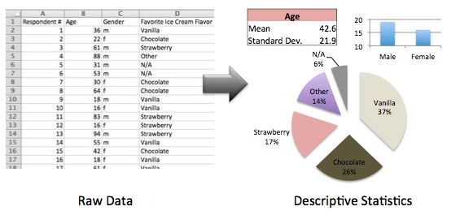
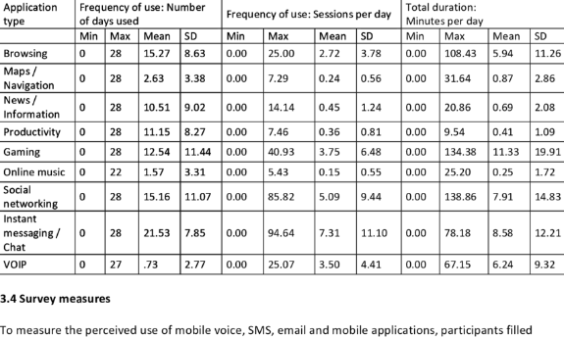
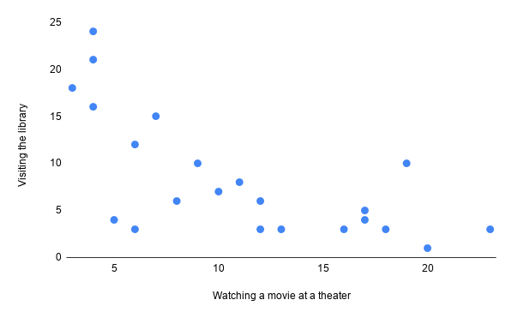
Types of quantitative data
descriptive, comparative or relationship
Descriptive data allows for a variable of the sample to be quantified.
  What is the average time spent in the computer lab per semester for a first year IT student?
Researchgate.com
mymarket research
Scribber.com

Slide 11
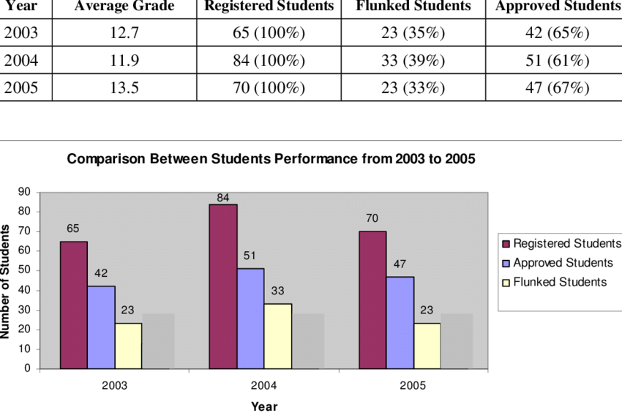
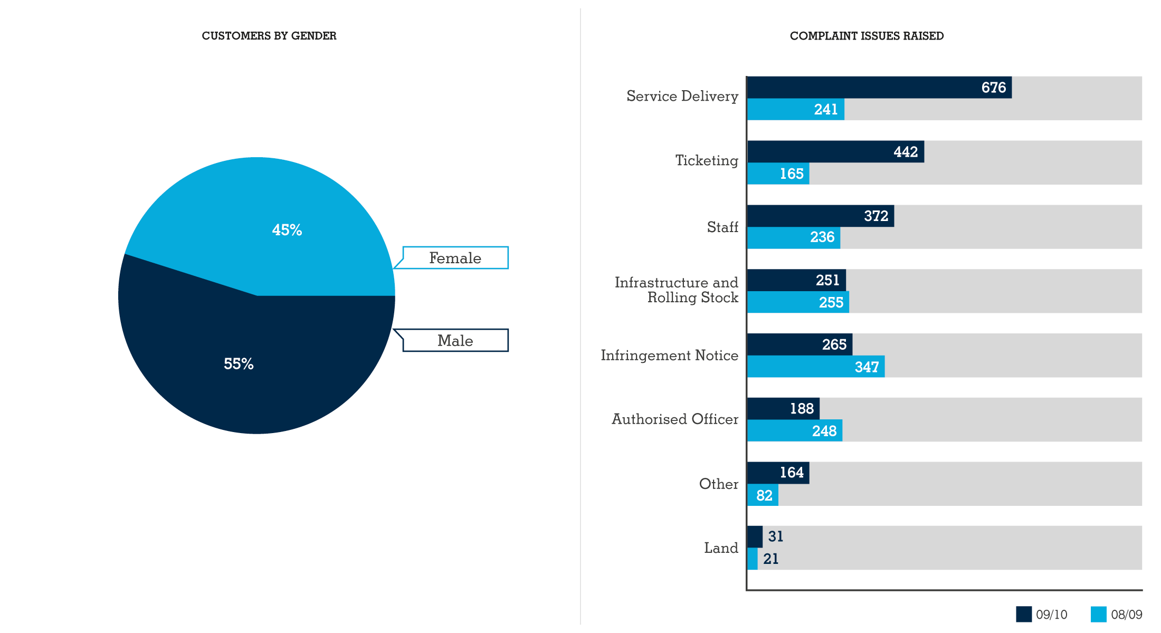
Comparative data allows for a comparison between two or more sample groups based on one or more variables.
  What is the difference in the average time spent in the computer lab per semester between the first year and final year IT student?
Researchgate.com

Slide 12
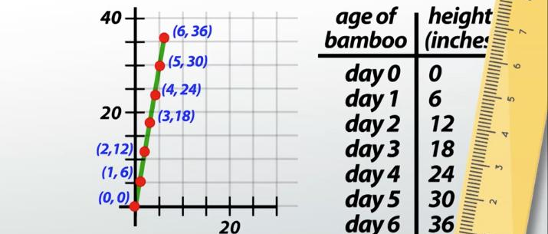
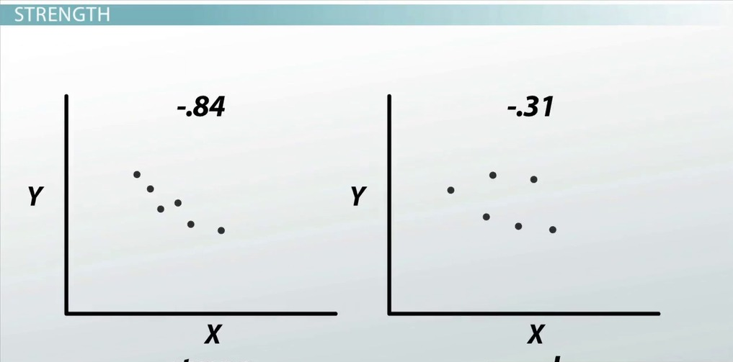
Relationship data highlights trends, relationships and associations between two or more variables.
  What is the relationship between time spent in the computer laboratory (X) and assessment marks (Y)?
Weak relationship therefore, Y has little impact on X
Strong relationship
study.com

Slide 13
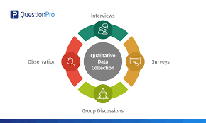

Qualitative data
Collected from a small group of participants
  10 to 15
in-depth and highly detailed
Aims to understand behaviors, motivations and feelings of participants
  E.g. rate the ease of use of the Chatbot on the university website
Interviews, focus groups, observations and expert opinion
  Much closer interaction and involvement with the research
QuestionPro.com

Slide 14

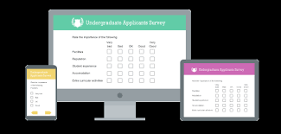
Survey
A survey is intended to collect data from a large sample of participants - quantitative.
Questionnaires are central to the survey
Online tool support for developing and administering surveys
  SoGoSurvey
  QuestionPro
  Surveymonkey
  Google forms
  Survey planet
Snapsurvey.com

Slide 15
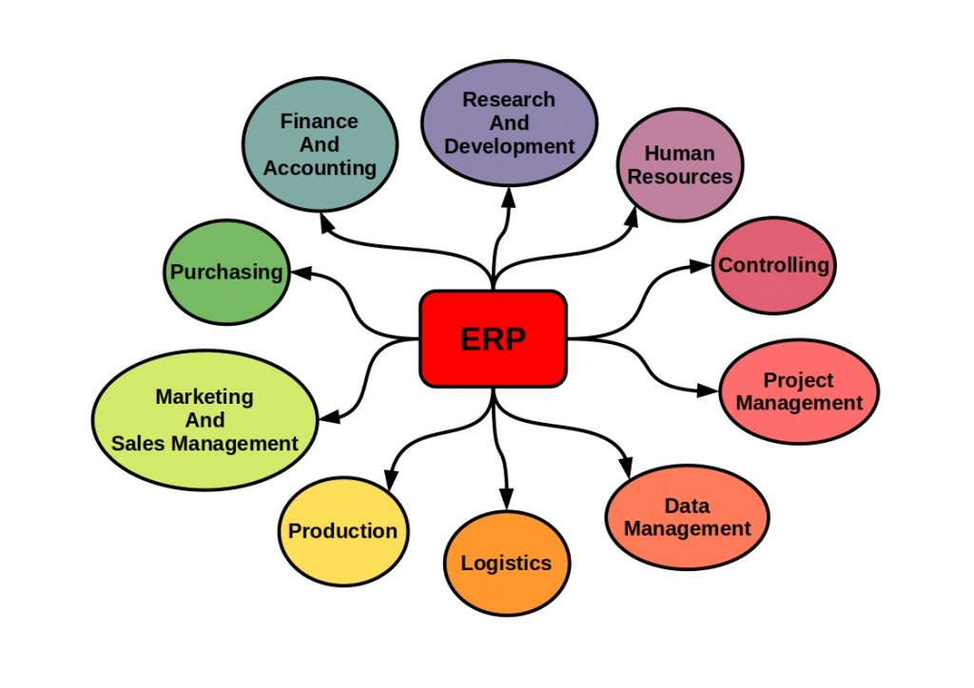
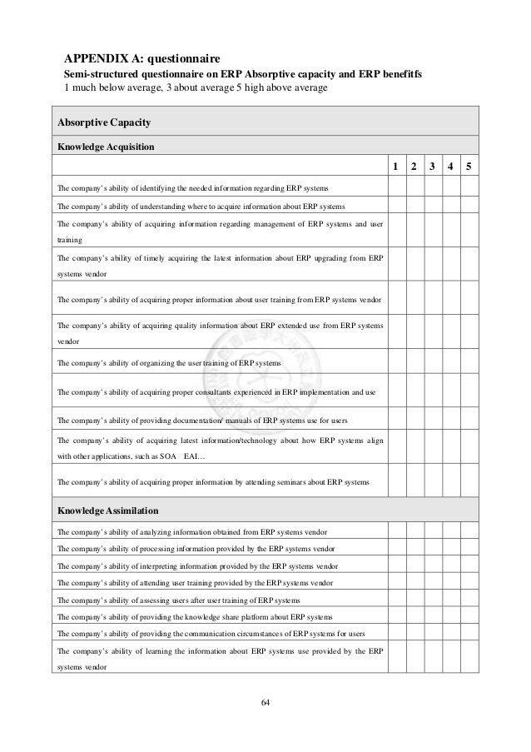
Developing the survey
Ask if the survey is the best suited strategy for the research
Begin with a literature review of the area of concern
For example, should the research aim to determine the most important SE factors for online learning platform implementation, then the literature review could first to identify the key knowledge areas e.g. Cost, Project Management practices, management support and infrastructure.
A survey could then be designed to collect data on these knowledge areas
Snapsurvey.com
Slideshare.com

Slide 16
Basic steps in conducting a survey
Determine the data that is needed from the sample/participants
Design the survey – think on the question designs and/or types
Use online tool to develop the survey
Pilot test the survey

Slide 17
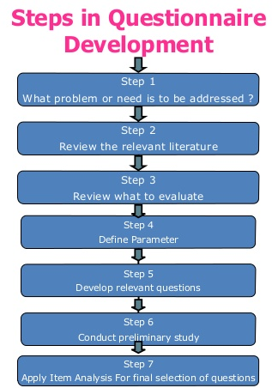
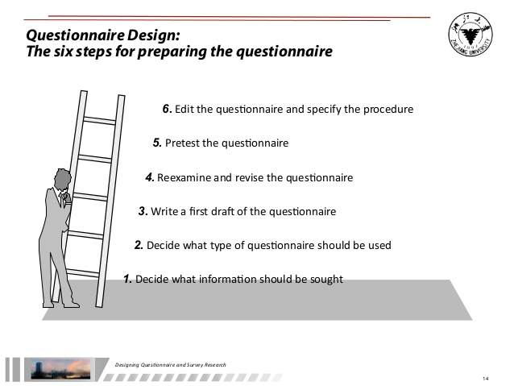
Tjitra, 2011
Sadgir, 2017

Slide 18
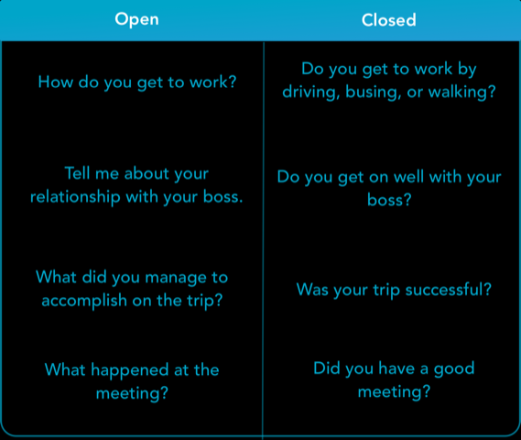
Question types
Open questions allow the participant any response in a blank space.
  Ask this type of question when exploring
Closed questions force the participant to select a response from a range of predefined responses.
  Ask this type of question when confirming or trying to determine a relationship between variables.
Chattermill, 2018

Slide 19
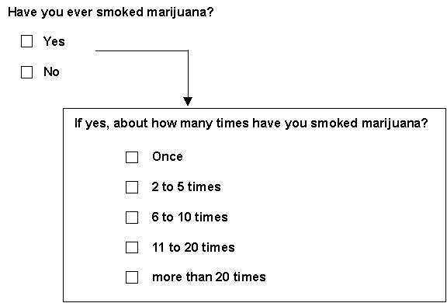
Types of questions
Dichotomous
MQC

Slide 20
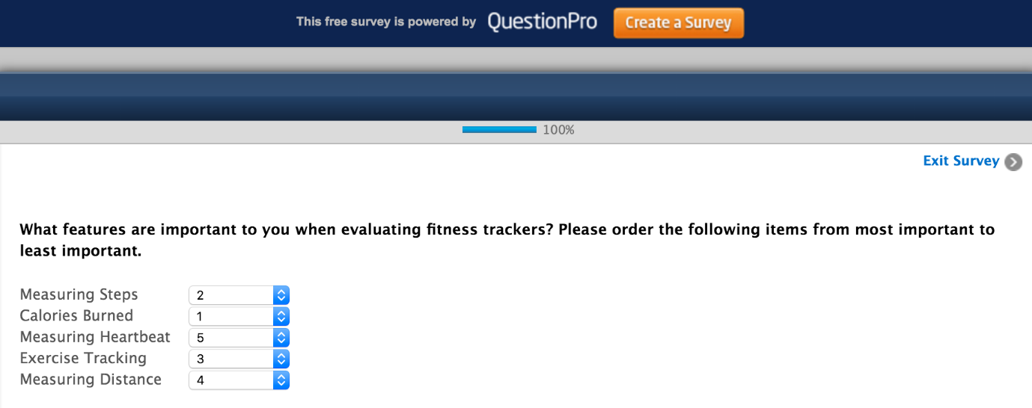
Ranked order

Slide 21
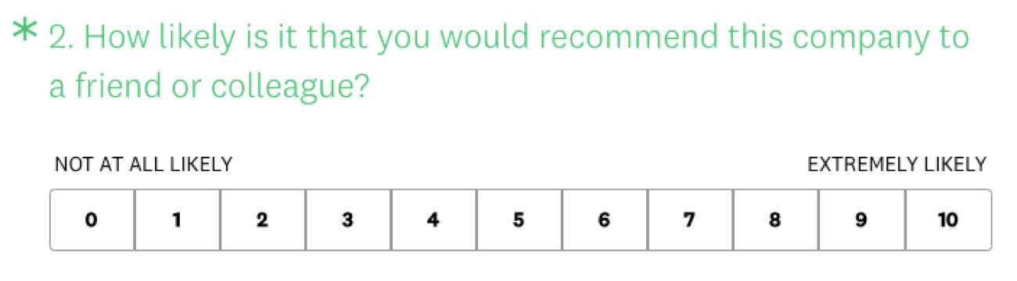
Rating scale

Slide 22


Focus group
Brings together a small group of experts - qualitative
These experts are able to comment on the research artefact, provide data on a topic or artefact
It is through interaction that responses are influenced by others which lead to more robust data collection

Slide 23
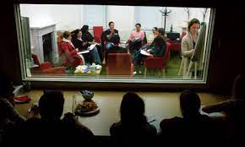



Types of focus groups
Two way - one focus group watches another focus group and discusses the observed interactions and conclusion
Dual moderator - one moderator ensures the session progresses smoothly, while another ensures that all the topics are covered
Duelling moderator - two moderators deliberately take opposite sides on the issue under discussion
Respondent moderator - one of the participants is asked to act as the moderator temporarily
Client participant - one or more client representatives participate in the discussion, either covertly or overtly
Mini focus groups - groups are composed of 4 to 5 members rather than 6 to 12
alamy.com
Wordpress.com
hexacta.com

Slide 24

Effective focus groups
Plan in advance
  duration, virtual location, materials required prior to interaction
Determine the size
  small group to interact with the artefact being developed or larger group for more data
Carefully consider selection criteria for participants
Moderator should have good people skills
The balance small business

Slide 25
Example
A conceptual model is developed during the literature review for improved analysis of public e-service websites
A focus group consists of software developers and engineers who have more than 10 years experience in e-service website projects
The focus group interacts with the conceptual model and provides feedback through 3 iterations i.e. three different days one week apart.
The focus group has a case study consisting of specs, the focus group uses the model to design the website to the specs.
After each iteration, the model is revised based on feedback from the focus group.

Slide 26
Factors for effective virtual focus groups
Consider the access to ICT and the reliability of these systems
The researcher needs to be well versed with the management and setup of these ICTs
Participants must be allowed time to familiarize themselves with the platform and practice its usage. Video, chat, and virtual hand-raising.
Consider the use of live camera feeds on the impact of responses and resource usage
What is the impact of excluding certain experts due to their non-access to ITCs?
Will the participants have access to a quiet space for the duration of the focus group
Muzzy (2020)

Slide 27
Online datasets
Many IT research projects make use of online datasets
This avoids the time consuming and costly activities of collecting data, transcribing or tidying up data and ethics approval.

Slide 28

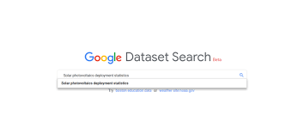



Some Advantages
Many available
Wide range of topical areas
Multi-regional
Extremely large volumes of data
Reduced time and financial resource usage
Avoid ethical processes
Can use multiple datasets
Validation via prior usage
Communities of practice associated with datasets

Slide 29
Read lecture note available on Moodle
  Be sure to cover the Pros and Cons
Attempt tutorials
Feel free to consult with me – alveens@dut.ac.za

